Slide 1

The Robotaxi Fleet Management Tool of the Future ✨ – by the Delamain Corporation
Lena Elisabeth Holtmannspötter, Emil Jeleskovic, Xuanqi Meng and Felix Schnabel HackaTUM
Garching, 24.11.2024

Slide 2
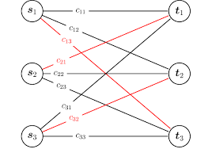
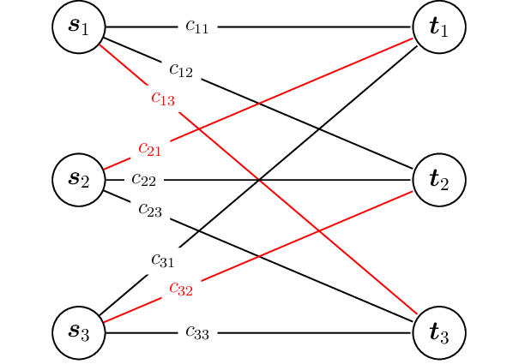

Our patented Optimization Algorithmen
Features:
Core of the algorithm: Cars are allocated based on a minimum average waiting time
Hunger-avoidance: Inspired by the Linux Kernel scheduler, we build a prioritizing allocation algorithm.
Energy-biased: To ensure vehicle longevity and protect the planet, a penalty is applied to over-utilized vehicles
Utilizing linear sum assignment to achieve a global minimum of average waiting time or to serve as a heuristic search tool for finding the best solution.

Slide 3
Live Demo

